Slide 1
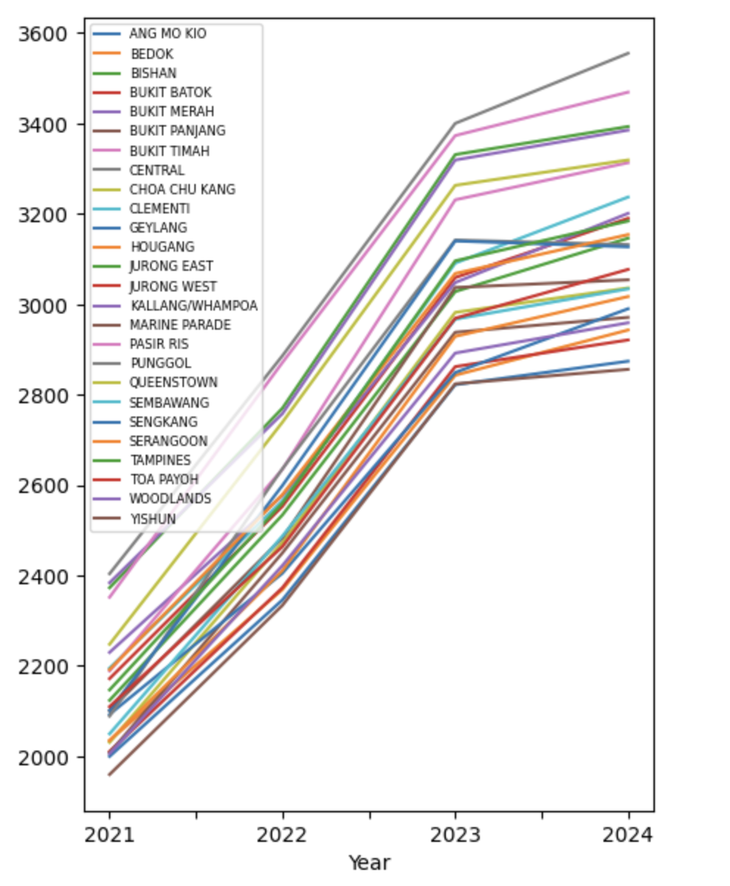
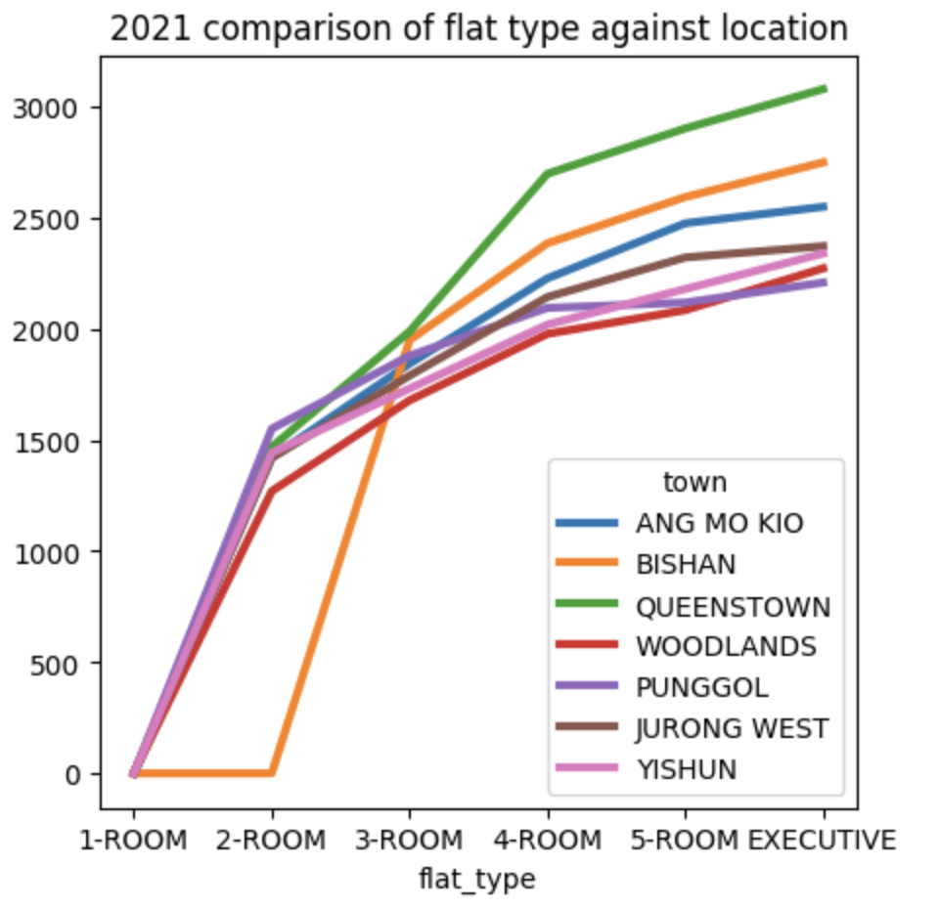
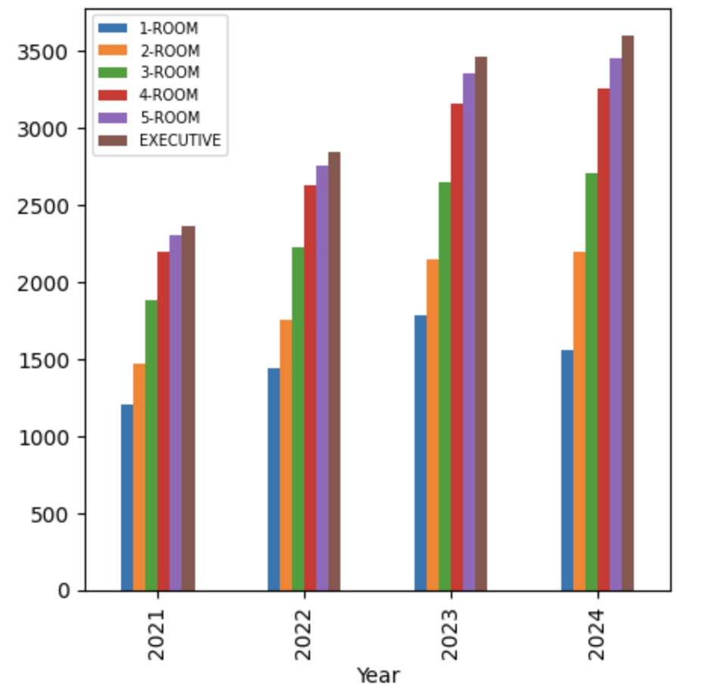
‘Internal’ Factors
Using the Renting Flats 2024 dataset provided, there are 3 main ‘internal’ factors to explore and consider if they have any impact on rent prices of HDB flats in Singapore:
Date (year)
Town
Flat type
Year x Flat type
Year x Town
Flat type x Town

Slide 2
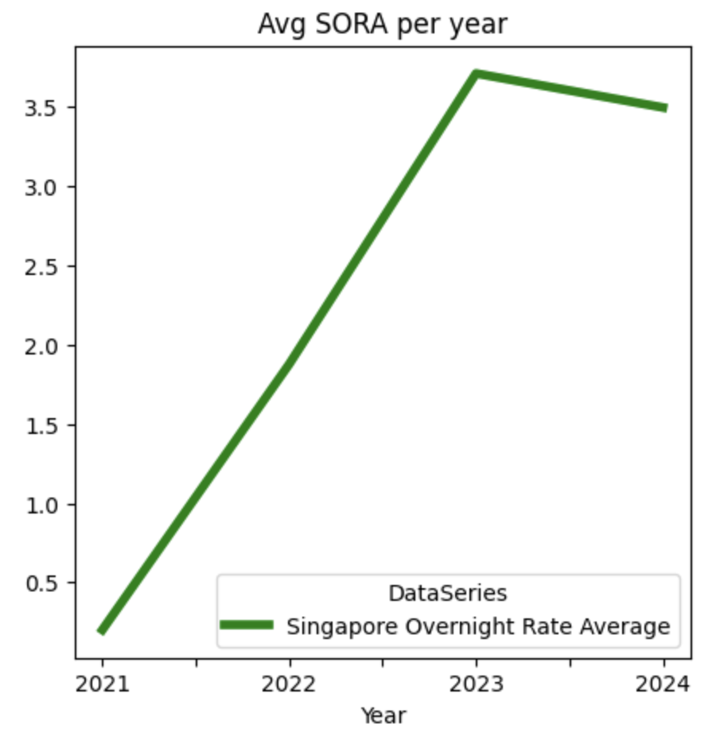
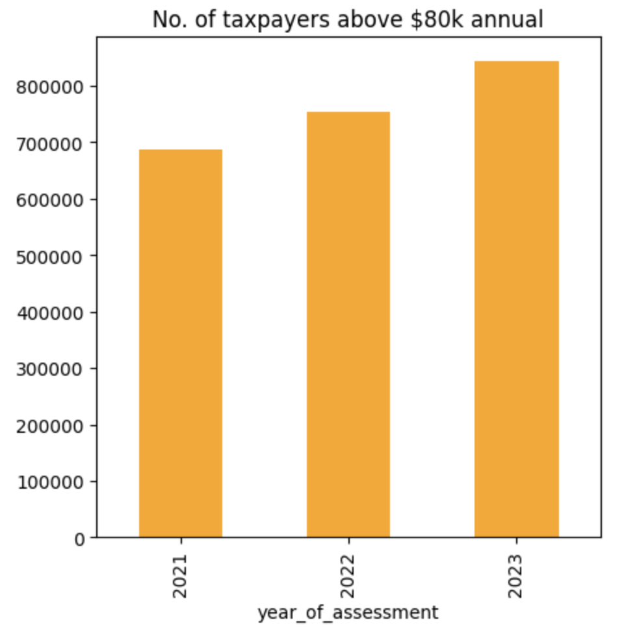
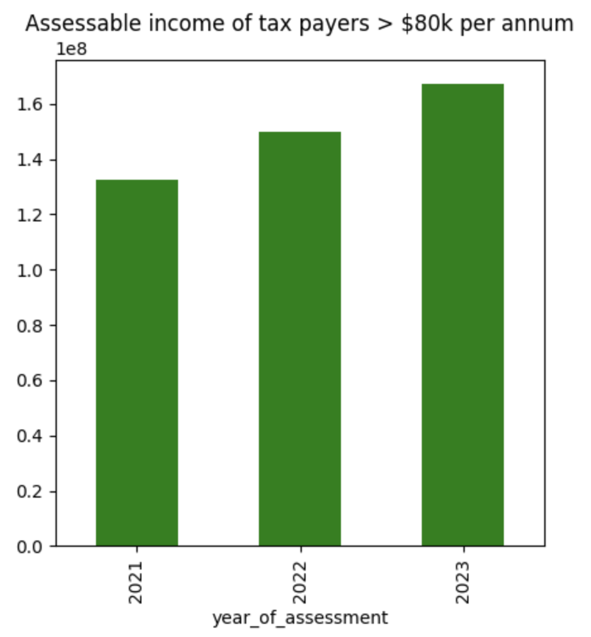
‘External’ Factors
There are factors which affect rent prices of HDB that are mostly outside of the housing environment as well:
Bank interest rates
Rising income levels
No. of foreigners in the workforce
Unemployment rate
Resale flat prices
Bank interest rate trend
Tax payers above $80k per annum

Slide 3
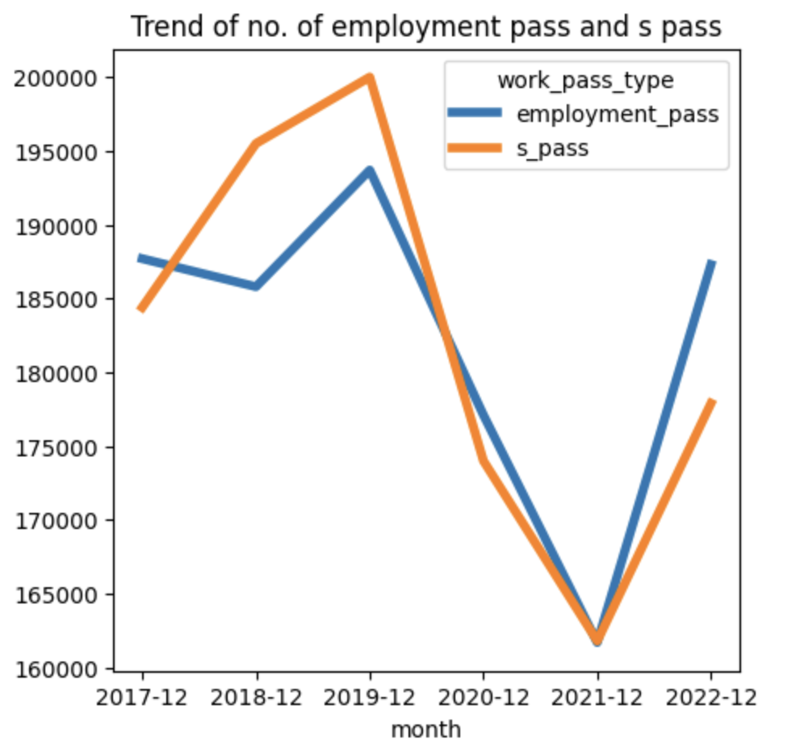
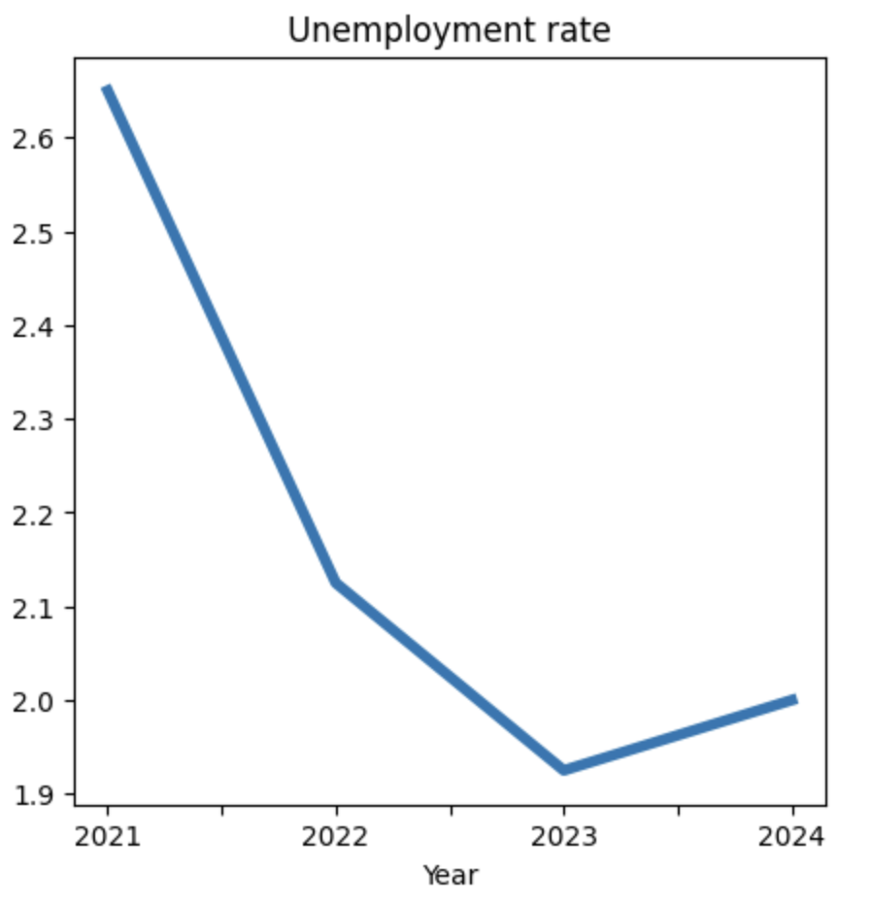
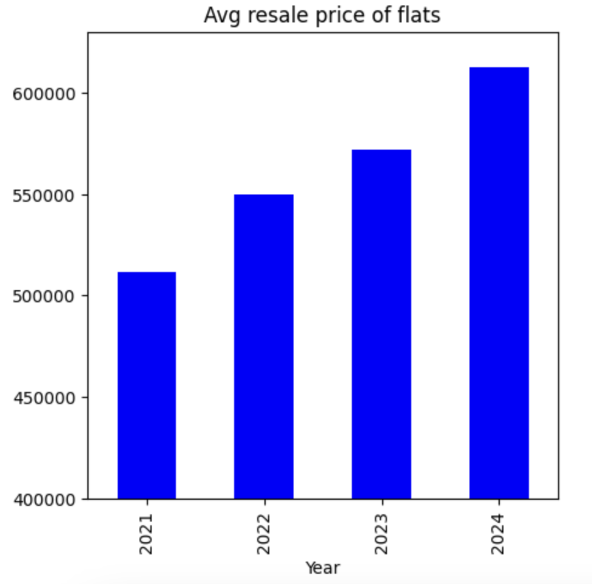
Continued
Employment and S Pass
Unemployment rate
Resale price of flats

